Slide 1

Working with Git and GitHub

Slide 2
Working with Git and GitHub
Brandon Reyes
Research Computing
Website: www.rc.colorado.edu
Helpdesk: rc-help@colorado.edu
Matthew Murray
Center for Research Data & Digital Scholarship (University Libraries)
Website: colorado.edu/crdds/
Helpdesk: crdds@colorado.edu

Slide 3


Goals
Learning Goals
Convince you that basic Git/GitHub fluency is:
Easy
Practical
An extremely important tool in your tool belt!
Understand the basics of version control
Know the differences between Git and GitHub
Learn basic Git fluency
Know how to collaborate with Git

Slide 4
Outline
What is version control?
Brief overview of Git and GitHub
When not to use GitHub
Creating your own repository locally
Pushing local changes to GitHub
Collaboration
Documentation

Slide 5
Have you set up Git/GitHub?
This is meant to be a mostly hands on tutorial. If you haven’t yet, you may still be able to get everything set up in time on CURC resources:
https://github.com/ResearchComputing/intro_to_git_github_fall_23#gitgithub-homework

Slide 6
What is version control?
Version control is the practice of tracking and managing changes to files.
Why do I need it?
Revert to various states of files
You can think of this as a backup
Allows you to modify items without harming the original copy
Not limited to code
Can be used for documents, images, etc.

Slide 7
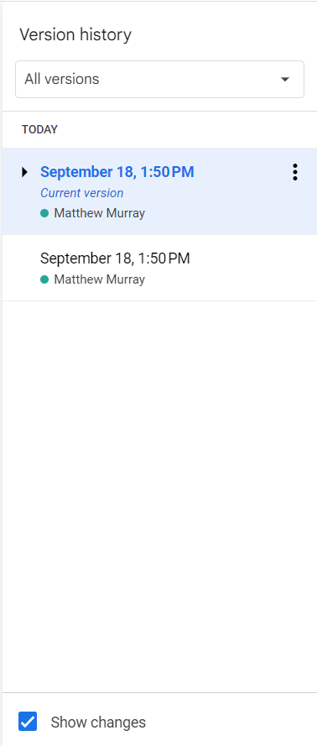
What is version control?
Google Docs includes "Version History"
This allows you to see what changes were made, when those changes happened, and who made them
You can also revert to a previous version of your file

Slide 8

Additional benefits of version control
Using version control provides
Clear tracking of the repo’s history
Management and view of different branches (work)
Collaboration through merging of branches
Main
Images: nobledesktop.com

Slide 9
Git vs GitHub
Git: version control system
the actual software
GitHub
cloud-based storage website

Slide 10
What is Git?
Git is version control software, created by Linus Torvalds, the same person who created the Linux operating system.
Monitor files on your computer and tracks changes made to them over time
Uses the command line

Slide 11
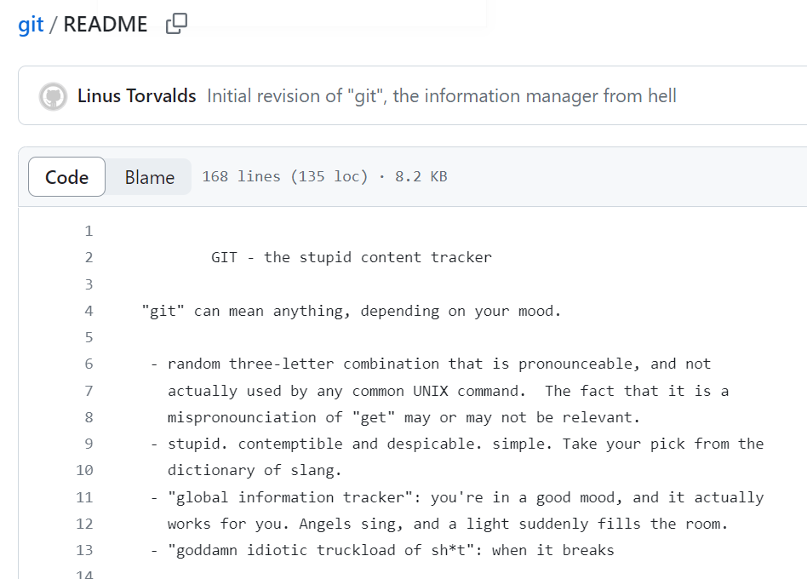
Why is it called “Git”?
Linus Torvalds: "I'm an egotistical bastard, and I name all my projects after myself. First 'Linux', now 'Git’”.
Git: “A silly, incompetent, stupid or annoying person (usually a man).” (Wikitionary)

Slide 12
What is GitHub?
GitHub is a Microsoft subsidiary that offers cloud hosting for Git repositories
Provides a GUI (Graphical User Interface) for Git
Not all features are available in the GitHub Desktop client
Allows for easy collaboration and sharing
Issue queues for bugs and features, pull requests, and more
GitHub basic is free (up to 5GB of storage)
Hosts both open and private repositories
GitHub Enterprise (free for CU affiliates)
Includes cloud-based development environments
https://oit.colorado.edu/services/business-services/github-enterprise

Slide 13


Alternatives to…
Git (version control)
Apache Subversion (SVN)
Mercurial SCM
CVS (Concurrent Versions System)
GitHub (hosting)
GitLab
BitBucket
SourceForge
Images from Wikipedia
Notes:
We’re going to stick to Git
industry standard
widely known
most resources

Slide 14
When not to use GitHub
When you are looking for long-term preservation
There’s no guarantee Microsoft will keep GitHub around forever
Thousands of URLs for projects in Git Hosting Platforms in articles no longer work
When you want your code to be cited
Zenodo is an Open Access repository that can be linked to GitHub
Allows you to archive a specific release of public GitHub projects
Creates a DOI for the archive that you can use in citations

Slide 15
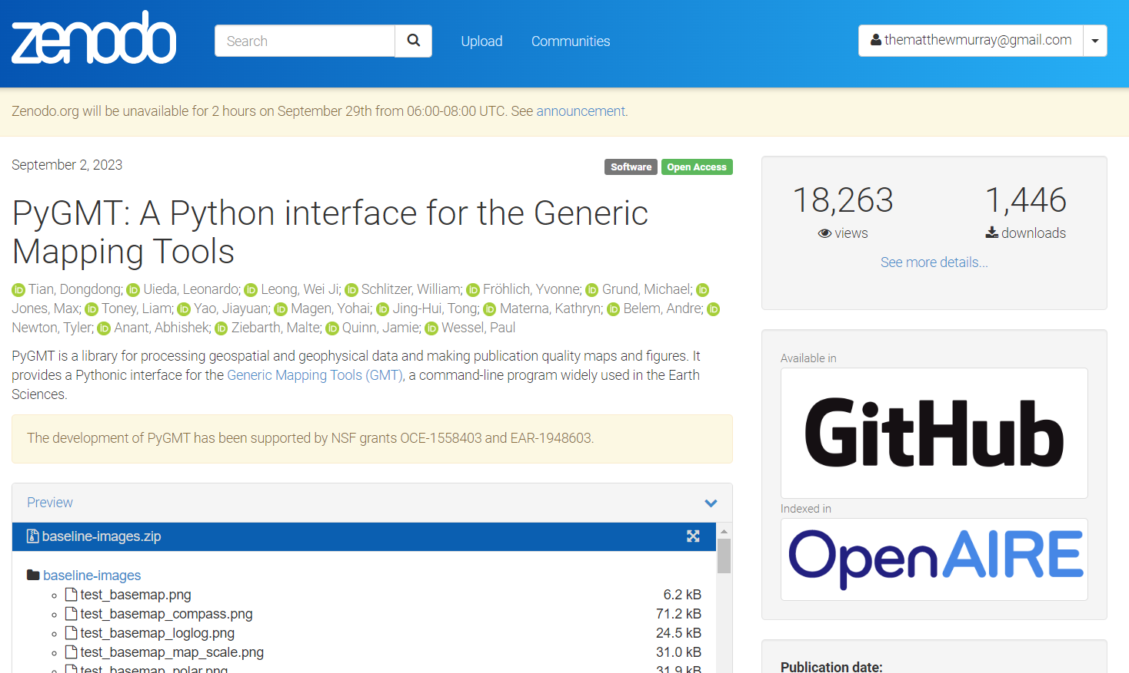

Slide 16
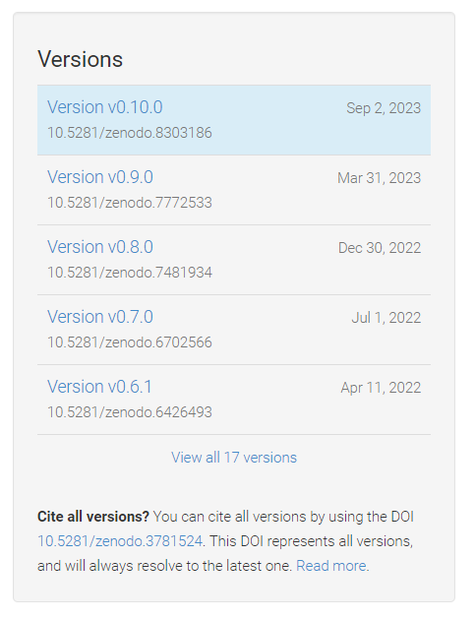

Slide 17
Getting Started with Git
(local)

Slide 18
Setting Git up locally
Many systems have Git installed; however, you may need to download it on your local machine
See https://support.atlassian.com/bitbucket-cloud/docs/install-and-set-up-git for more information
Today I am going to stick with using Git on a CURC login node

Slide 19
Logging into RC via a Terminal
To login to an RC login node:
$ ssh <username>@login.rc.colorado.edu
Supply your IdentiKey password and your Duo app will alert you to confirm the login
Confirm Git has been configured (by you using the README)
$ git config --list

Slide 20
Hands on tutorial
Goal: Create a simple project that contains a markdown file
First let’s create a new directory for our project:
$ cd /projects/$USER
$ mkdir git-tutorial
$ cd git-tutotial

Slide 21
Git Repository (Repo)
A Git repository tracks and saves the history of all changes made.
All of this information is stored in “.git”, which is the repository folder
We can make a directory (folder) a Git repo using “git init”

Slide 22
Git Init
In your “git-tutorial” directory run
$ git init
Git creates the "hidden" directory called “.git”
$ ls –a
Your directory is now a repo!
Git is now ready to to be used
Allows us to tell Git what items to watch

Slide 23
Create the main branch
Now that we have a repo, we can create branches. Branches are a version of the repository.
It is customary to name the primary branch “main”
This can be done as follows (after an init)
$ git checkout –b main
You can switch between branches
$ git checkout <branch-name>
Main

Slide 24
Let’s add a file!
It is customary to add a README.md
Description of repo and any helpful information
To add a README.md, in “git-tutorial” create and edit the file using nano (or an editor of your choice)
$ nano README.md
Add anything you would like!
Be sure to save the file when you exit.

Slide 25




Git does not know about README.md yet!!

Slide 26
Areas of Git Workflow
Working Area
Items that you are currently working on
Are not tracked by Git!
Exists locally
Staging Area
When Git starts tracking and saving your work
Exists locally
Items are added to this area by using “git add”
Snapshot Area
All staged items are captured
Version of the repo
Exists locally
Items are added to this area by using “git commit”
GitHub
Exists locally and on GitHub!
Items are added to this area using “git push”

Slide 27
Git Status
The git status command displays the state of the working and staging area.
Let’s see what area README.md is in
$ git status
We see it is an untracked file, so it is in the working area

Slide 28
What if you don’t want Git to track something?

Slide 29
.gitignore
We can add a file named “.gitignore” to our repo
Specifies what items (files, directories, etc.) should never be tracked
Let’s create a file to ignore!
$ echo "Super secret stuff" > confidential_data.txt
Add “.gitignore” to “git-tutorial” and put “confidential_data.txt” in it
$ echo confidential_data.txt > .gitignore

Slide 30
Let’s add our files to the staging area now!

Slide 31
Git Add
The git add command adds a change in the working area to the staging area
Let’s add our README.md to the staging area
$ git add README.md
or add everything in the current directory
$ git add .
Anytime a change is made, you need to do a git add (to track them)
Working Area
Staging Area
Snapshot Area
GitHub
git add

Slide 32
Git Commit
The git commit command captures a snapshot of all staged items
Commits can be thought of as a version of the repo
Commits should be accompanied with a brief message
Let’s commit our staged item!
$ git commit -m ‘Create repo, add README.md, add .gitignore’
$ git status
Working Area
Staging Area
Snapshot Area
GitHub
git add
git commit

Slide 33
Common practice – add, commit
git add
Can be performed as much as you want
Doesn’t need to be done after every change
git commit
Always include a comment!!
Bundle common staged items together
Try not to put too many things in a commit

Slide 34
Git Log
The command git log lists the commits made in that repository
Lists the most recent commits first
$ git log

Slide 35
All changes and files are only locally stored right now!

Slide 36
To GitHub we go!

Slide 37
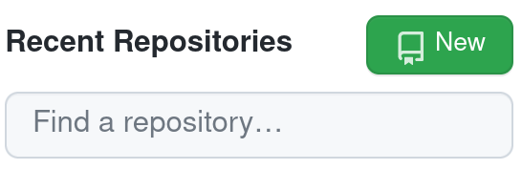
GitHub
When you first create a repo locally, you will need to setup a new repository on GitHub too
Go to https://github.com
Sign in
Click on “Create New Repository” or just “New”

Slide 38
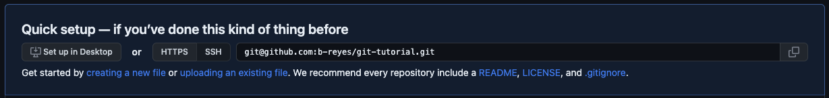
Create Repo in GitHub
Name your repo, I chose “git-tutorial”
Don’t add a README or a .gitignore
Click “Create repository”
We have set everything up in the previous slides, we only need to copy the ssh link!

Slide 39
Linking local repo to GitHub repo

Slide 40
Git Remote
Used to identify the remote (e.g. GitHub) repos are linked to your local repo
Used to link remote repos to your local repo
To view currently linked remote repos:
$ git remote -v
To link our remote repository:
$ git remote add origin git@github.com:<user>/git-tutorial.git

Slide 41
Sending local changes to GitHub

Slide 42
Git Push
Uploads local repository content to a remote repository
Pushing is how you transfer commits from your local repo to a remote repo
$ git push <name of remote repo> <branch>
$ git push origin main
Working Area
Staging Area
Snapshot Area
GitHub
git add
git commit
git push

Slide 43
GitHub
Go back to GitHub and refresh your page
should see the files we have added (and not the ones we’ve ignored)
Some cool features!
look at our commits
directly edit/commit in the browser
Let’s do that! Let’s something and commit it on GitHub
But now our remote repo is one commit ahead of our local one…

Slide 44
Git Fetch & Merge
Git fetch retrieves the changes from the remote repo
$ git fetch
Git merge combines two branches
$ git merge origin/main
There’s an easier way!

Slide 45
Git Pull
Git pull combines the fetch and merge commands
$ git pull <name of remote repo> <branch>
$ git pull origin main
IMPORTANT!
Make sure no commits have been done on local branch
It is fine to have staged items (git add)
ALWAYS do git pull before any commits!

Slide 46
Advanced topic (time permitting): Collaboration

Slide 47

GitHub Forks
Pull Request (PR)
Main Branch
Your Main Branch
Central Repo
(upstream)
Your Forked Repo
Fork

Slide 48

GitHub Forks
Improves collaboration
Don’t have to worry about disturbing the upstream repo
Improves transparency through pull requests
Go ahead and Fork my repo:
Go to https://github.com/b-reyes/git-tutorial
Click “Fork” button
Click “Create fork”
Creates your own version of my repo under your GitHub

Slide 49
Git Clone
Git clone makes a clone (or copy) of a remote repo in a new directory, at another location.
$ git clone <url> <optional new name>
Easy way to grab third-party code, or pre-existing code you might need to work on
$ cd /projects/$USER
$ git clone git@github.com:<user>/git-tutorial.git

Slide 50
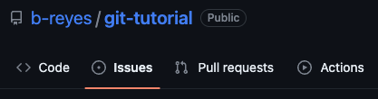
GitHub Issues
Allows you to discuss the project
Point out issues, request features, ask for help
Useful place to see past user discussion

Slide 51
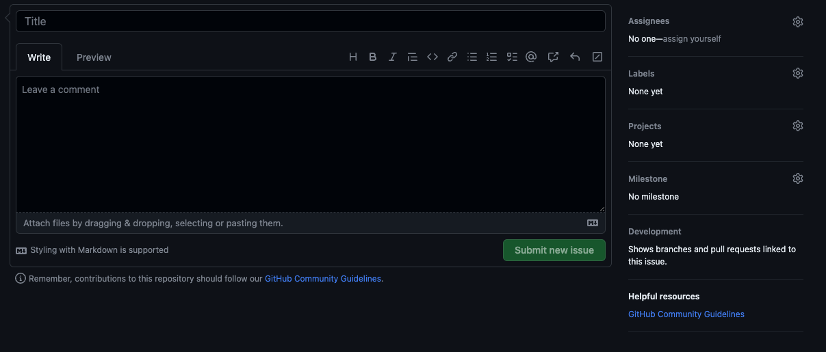
GitHub Issues
Include as much detail as possible
Version of software
Operating system
Provide a simple minimal example, if possible
If a feature request
Outline possible implementation
Highlight its value

Slide 52
Pull Requests (PRs)
A request that an upstream repo pull your branch into their branch
Starting a PR does not automatically merge changes
Notifies maintainers of upstream repo
Allows maintainers to review your changes
Discussion of changes
Requested additional changes
Maintainers of upstream repo merge in the changes

Slide 53
PR steps
Fork upstream repo
Clone the forked repo
Connect forked and cloned repo to upstream repo
Create a new branch specific to your change
Make your changes on this branch
Perform a git add, commit, and push to origin
Create a PR from GitHub
$ git remote add upstream git@github.com:b-reyes/git-tutorial.git
$ git checkout –b <new-branch> <branch-to-copy>

Slide 54
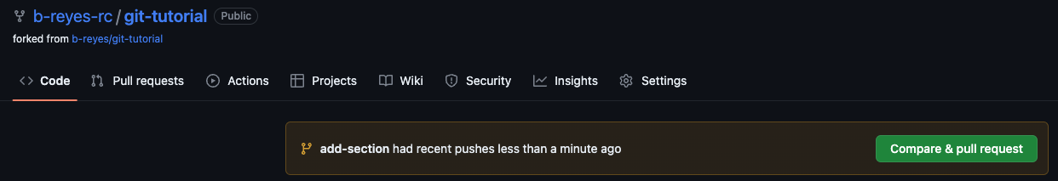
Creating a PR
After you push your changes to the forked repo, you can click the pop-up “Compare & pull request” on GitHub
Will disappear after some time

Slide 55
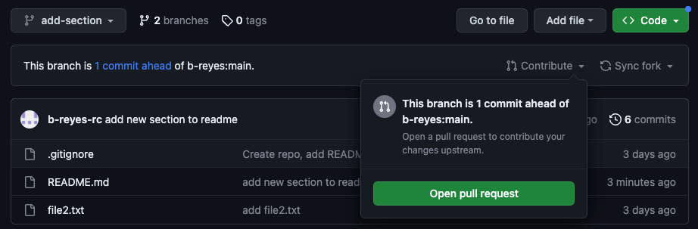
Creating a PR
After you push your changes to the forked repo
Switch to your new branch
Click the drop-down arrow next to “Contribute”
Click “Open pull request”
Will NOT disappear!

Slide 56
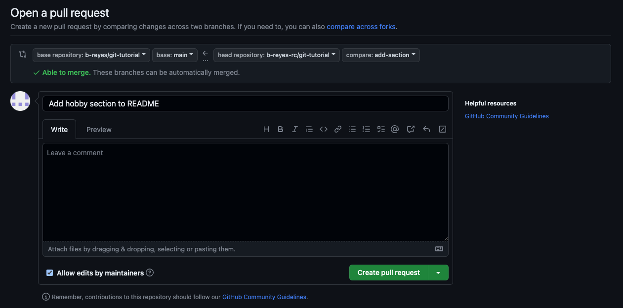
Creating a PR
Our forked repo and branch with our changes
Upstream repo and branch we want to merge into

Slide 57
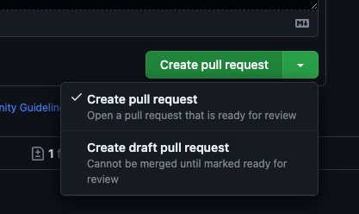
Pull Requests – Best Practice
Create a new feature branch of forked repo
When submitting a PR
Provide a short descriptive title
In comment section
Link to any current issue
Describe what the PR does and reasons for it
Draft pull requests
PR is a work in progress
Can be used for discussion

Slide 58
Merging
When doing a “git pull” you are merging in changes
This process can be done manually
When collaborating, multiple individuals can be working on the same item
Conflicts can happen!
One needs to manually resolve conflicts
Fantastic tutorial on merging:
https://www.atlassian.com/git/tutorials/using-branches/git-merge

Slide 59
Help! I’m stuck, where do I go?
Trainings with Center for Research Data and Digital Scholarship (CRDDS): https://www.colorado.edu/crdds/
Software Carpentries tutorial: https://swcarpentry.github.io/git-novice/index.html
GitHub Student Developer Pack: https://education.github.com/pack
Helpdesk: rc-help@colorado.edu

Slide 60
Best Practices: Documentation
Include documentation with your project in GitHub so that others (and you) know what your project is and how it should be used.
A README.md (markdown) file can be included in your GitHub project and will display on the front page
What to include in a README:
What your project does
How people can use it
Who you are and how to contact you
License information
Lots of examples and templates available

Slide 61
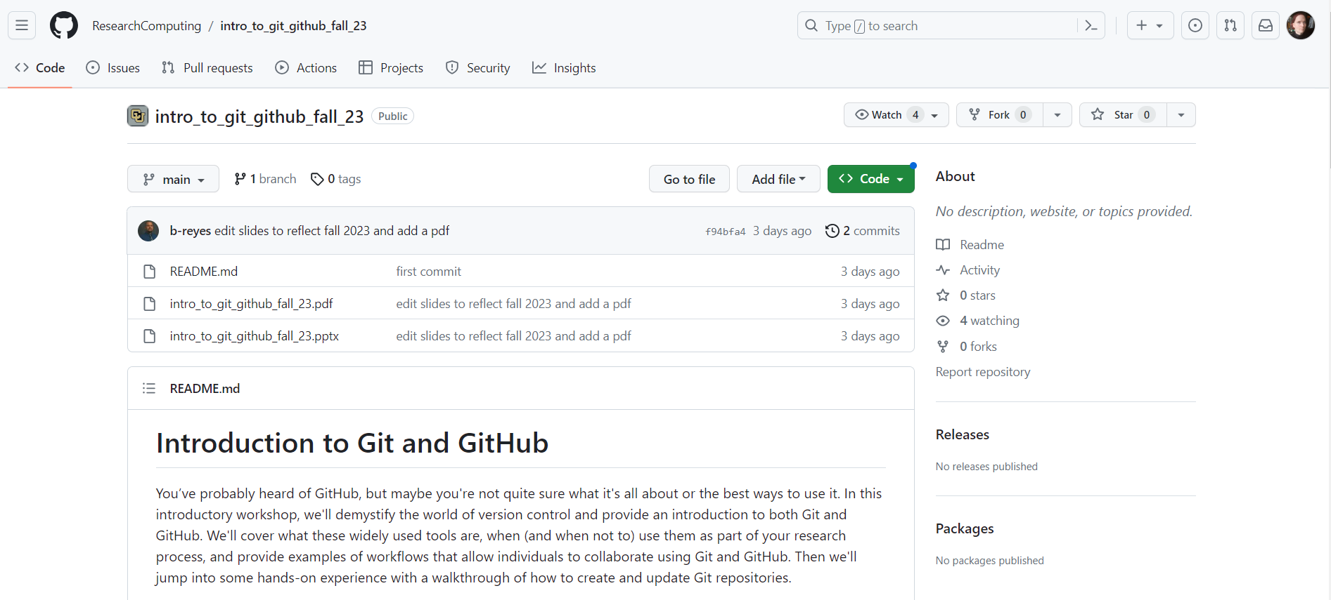

Slide 62
Thank you!!
Survey: http://tinyurl.com/curc-survey18

